Slide 1


Slide 2
Oracle
Account Payable

Slide 3
Account Payable
Group

Slide 4
Brief Definition of Accounts Payables
Accounts Payables (AP) represent company's financial obligation to pay suppliers for goods or services purchased on credit.
These are short-term liabilities that must be settled within a specific period and are a crucial part of the accounting cycle.

Slide 5

Importance
1
OF USING ORACLE FOR
5
4
3
2
*
ACCOUNT PAYABLE MANAGEMENT

Slide 6
1
The Oracle Accounts Payables system helps businesses automate and efficiently manage the payment process through :
5
3
4
2
*

Slide 7
Accelerating invoice entry and processing to reduce time and effort.
1
5
4
3
2
*

Slide 8
Enhancing data accuracy and minimizing human errors through integration with other systems like Procurement and Inventory.
5
1
4
3
2
*

Slide 9
Providing detailed reports and analytics to support financial decision-making.
5
1
4
3
2
*

Slide 10
Ensuring compliance with company financial policies and procedures.
5
4
1
3
2
*

Slide 11
Improving cash flow management by scheduling and prioritizing payments.
5
1
4
3
2
*
So, Using Oracle makes managing accounts payables more efficient and transparent, supporting the operational efficiency of businesses.

Slide 12



Objectives Of The Project
1
2
3
Automating payment processes
Improving invoice management
Ensuring data accuracy
and minimizing errors through system integration and validation.
to enhance efficiency and reduce manual work.
for better tracking and organization of supplier transactions.

Slide 13






W O R K FLOW
03
Payment
06
04
General Ledger
01
Clearing
Supplier and payment batches
02
05
Invoices
Closing

Slide 14
Procure to Pay P2P
01
Purchase Requisition
02
Buyer (Purchasing Team)
PR
DR Charge Account
CR Commitment Reserve Encumbrance
No Entry
Buyer
03
Supplier / RFQ
04
Quotation
Supplier/ RFQ
No Entry
No Entry
Quotation
05
Purchase Order
06
Receiving
DR Commitment Reserve Encumbrance
CR Charge Account
DR Receiving Area
CR Ap Accrual
PO
DR Charge Account
CR Obligation Reserve Encumbrance
Receiving
DR Obligation Reserve Encumbrance
CR Charge Account
07
Inspect
08
Deliver
No Entry
Deliver
DR Raw Material \ Assets \ Expenses
CR Receiving Area
Inspect
09
Invoice
10
Payment
DR AP Accrual
CR Liability
Payment
DR Liability
CR Cash Clearing
Invoice

Slide 15
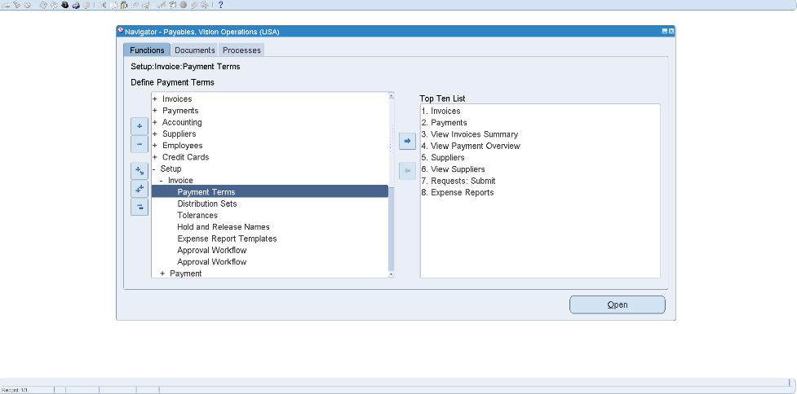
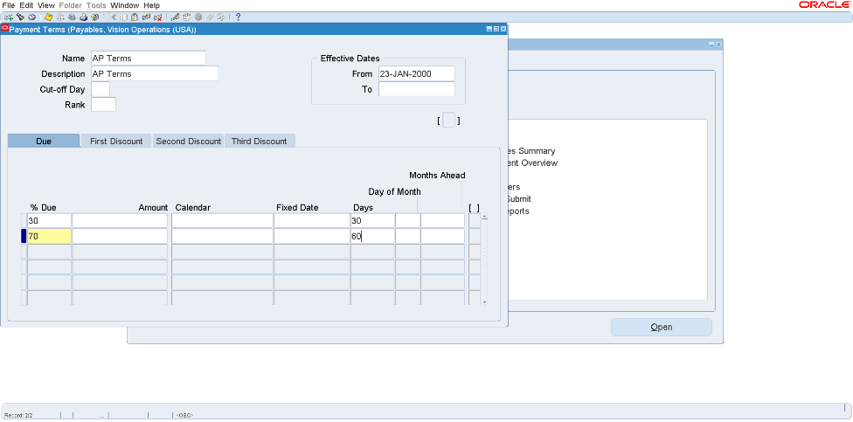
Making payment terms
01
Supplier and payment batches
Setup
Invoices
Payment terms
2
1

Slide 16
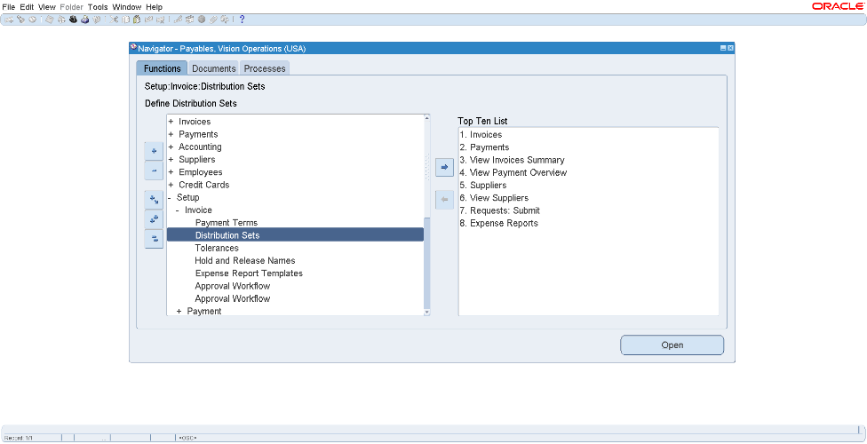
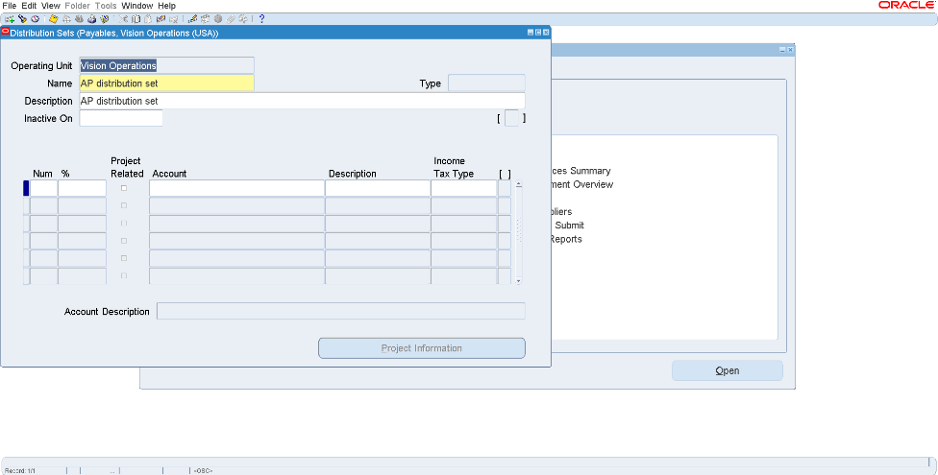
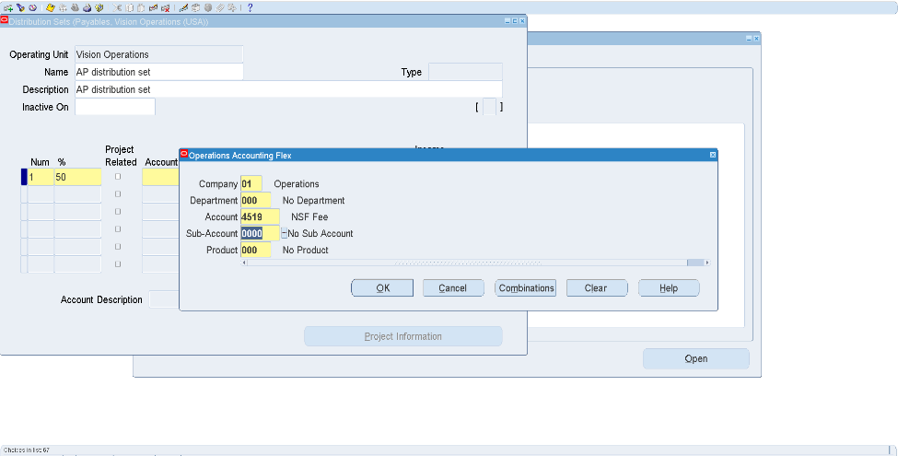
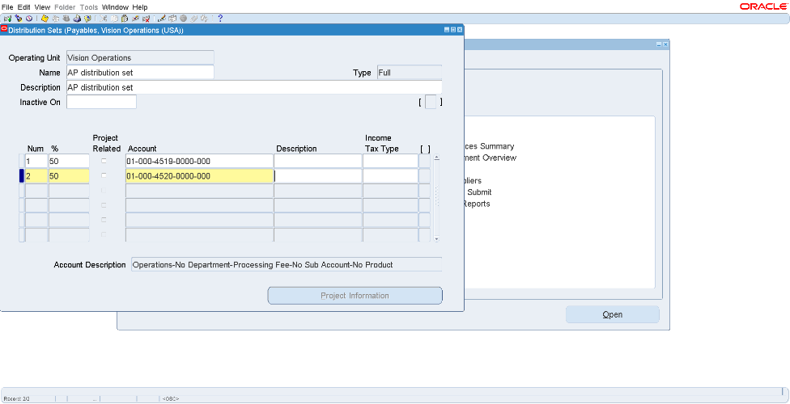
Making Distribution Set
Setup
invoices
Distribution Sets
1
2
Ctrl+s

Slide 17
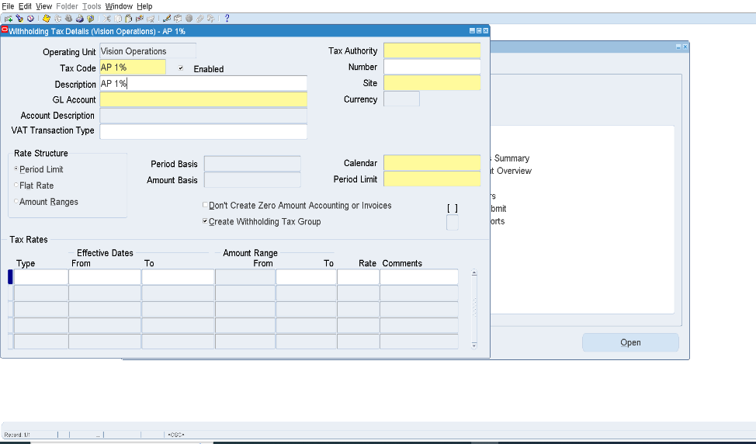
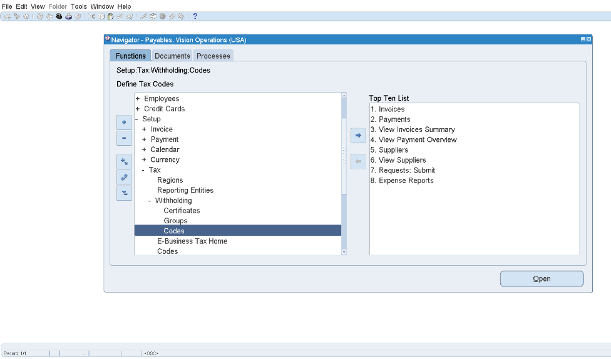
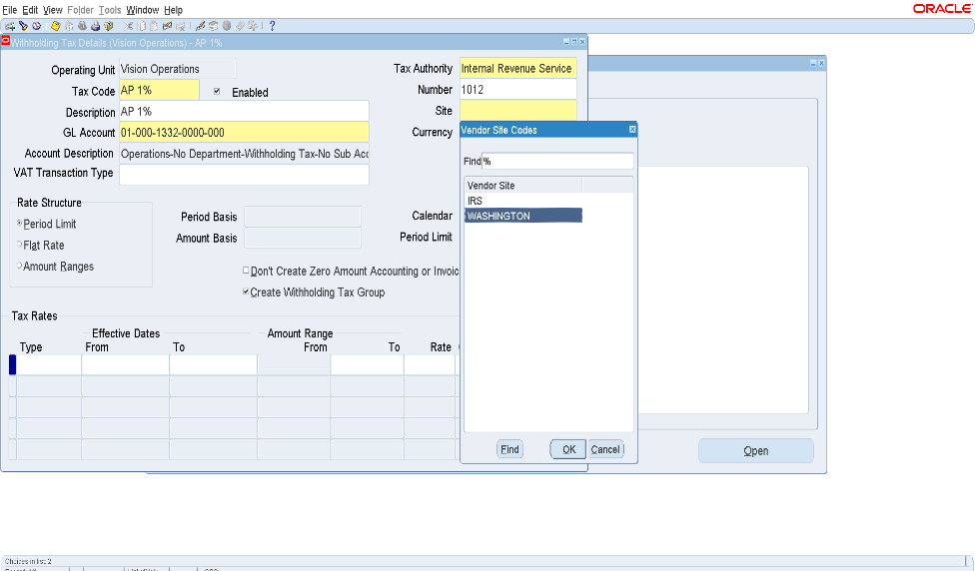
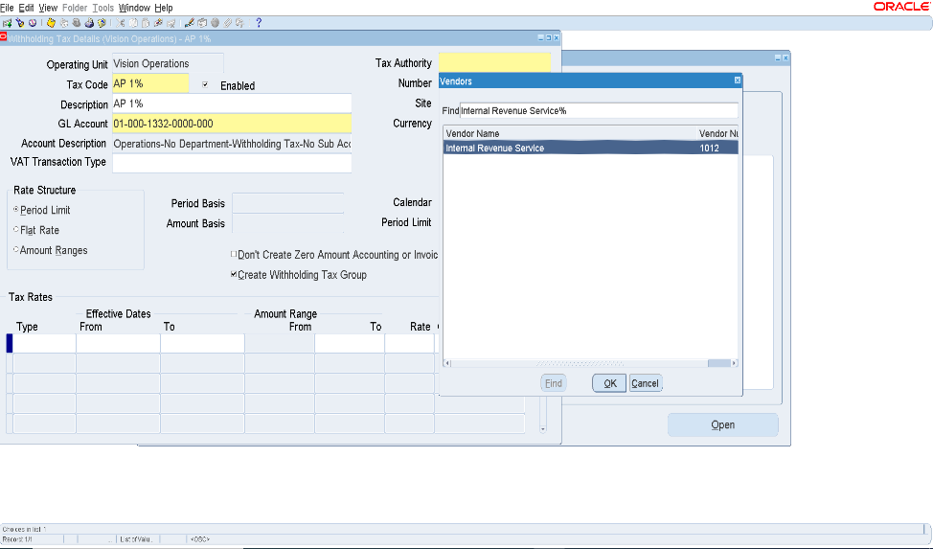
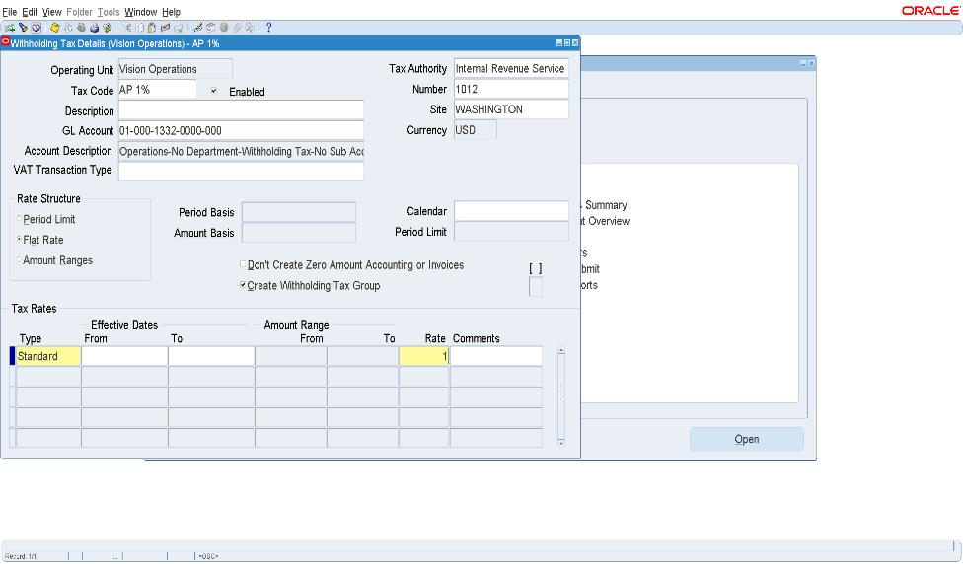
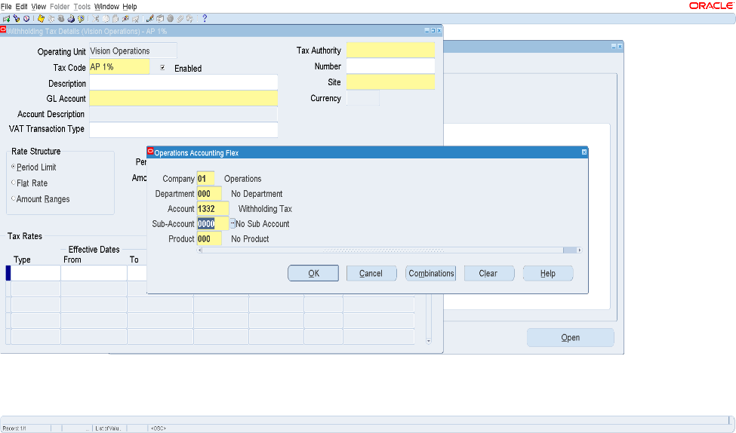
Making withholding
Withholding code
Setup
Tax
Withholding
Code
5
6
2
1
7
3
4

Slide 18
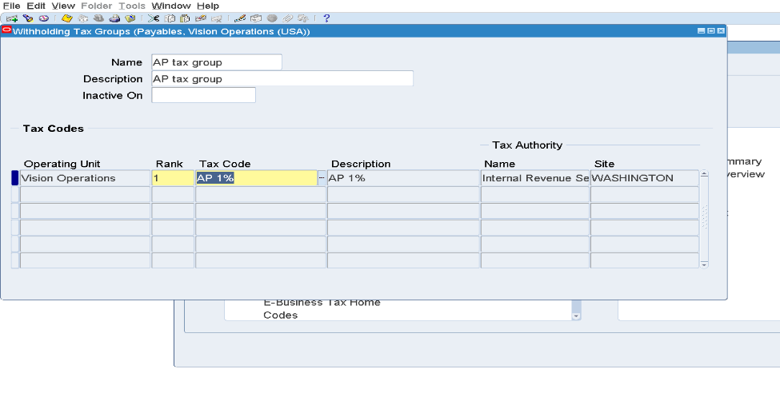
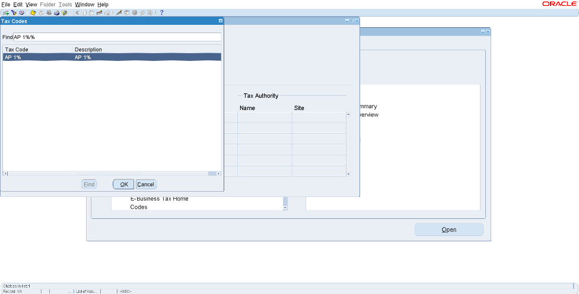
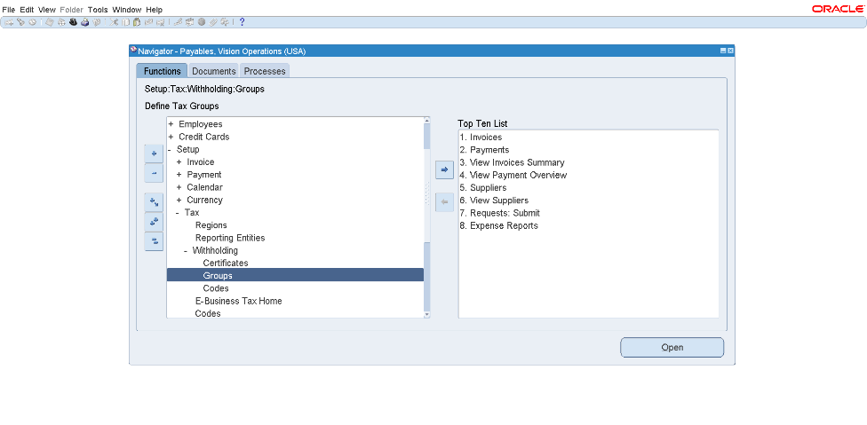
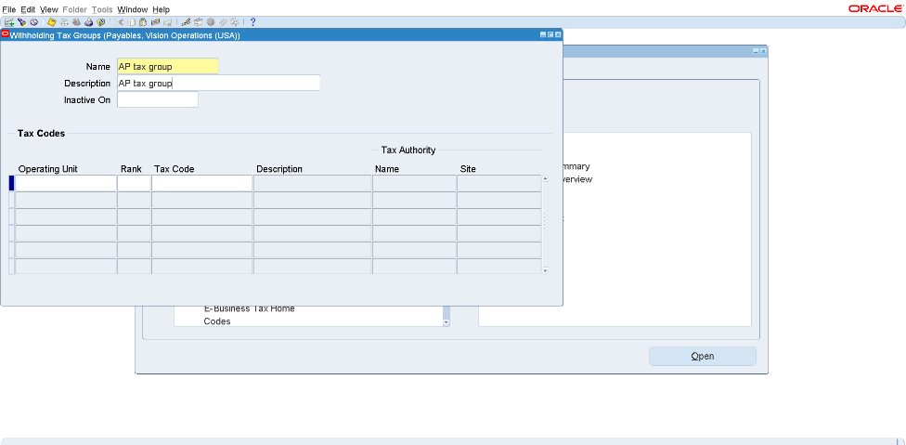
Withholding Group
Setup
Tax
Withholding
Groups
Find withholding tax code
1
Click CTRL+Save

Slide 19
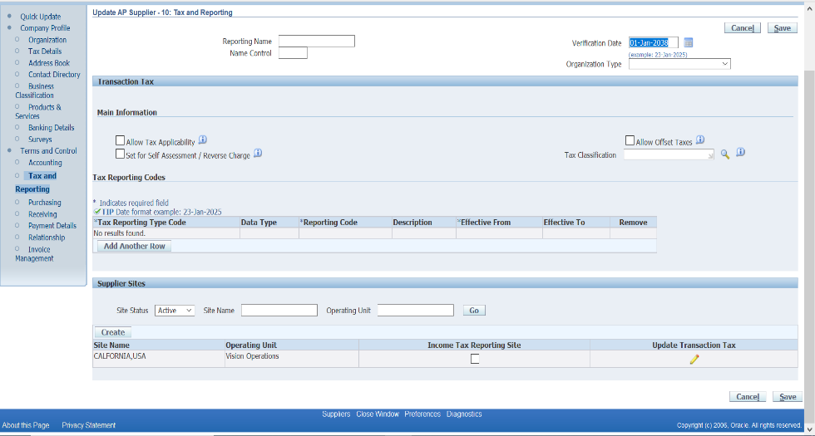
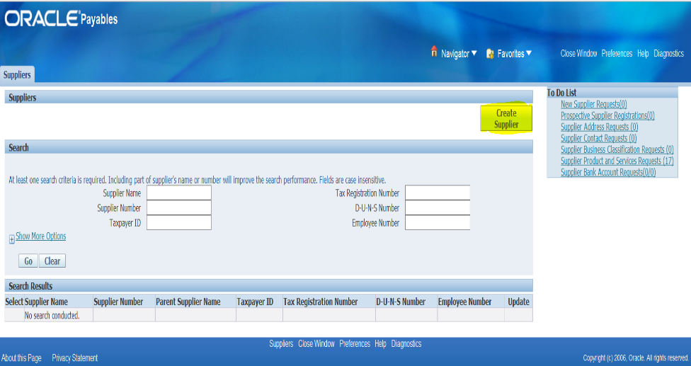
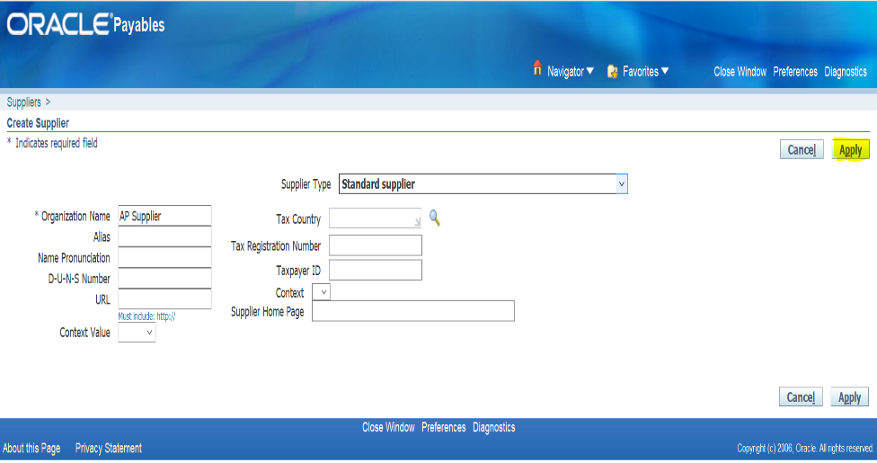
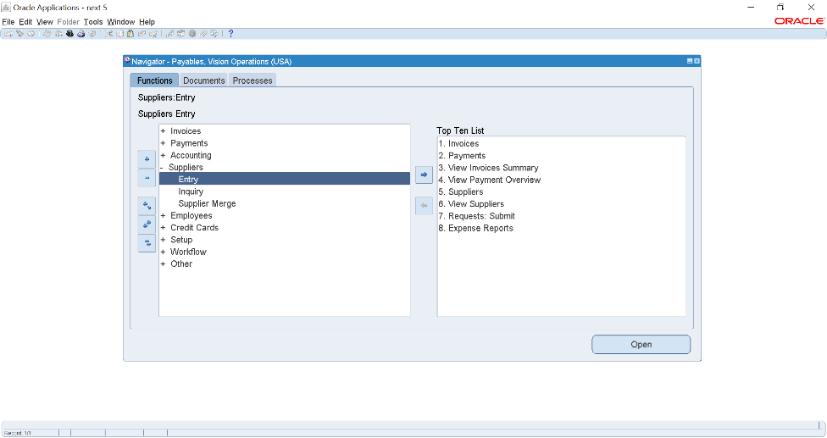
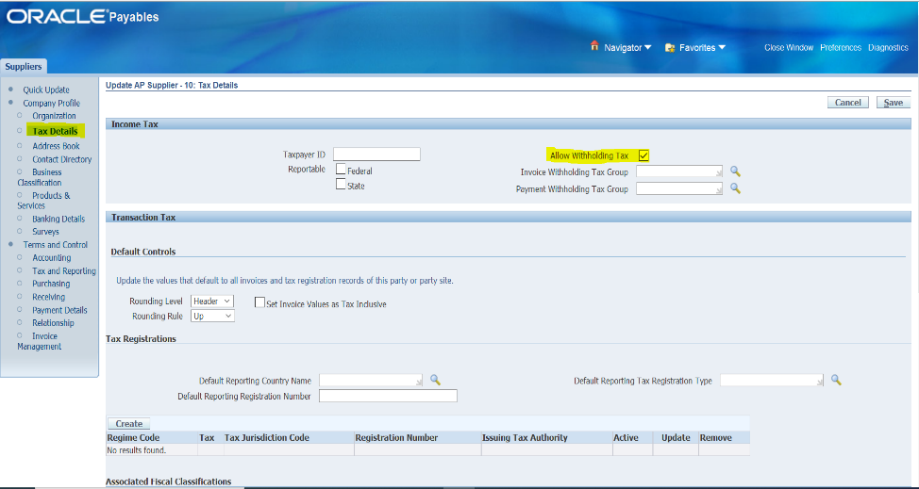
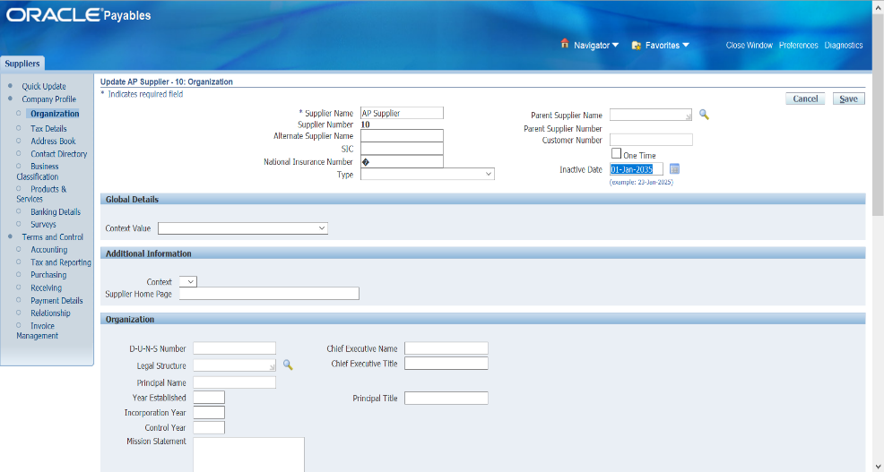
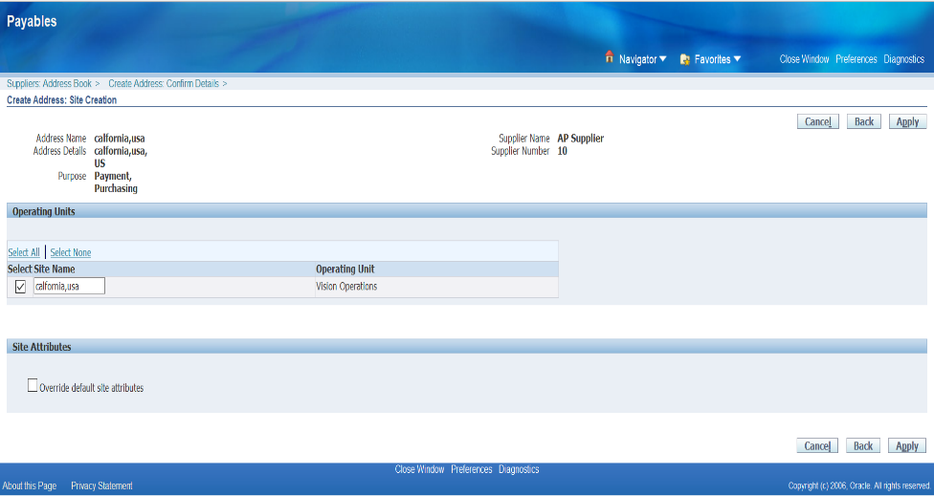
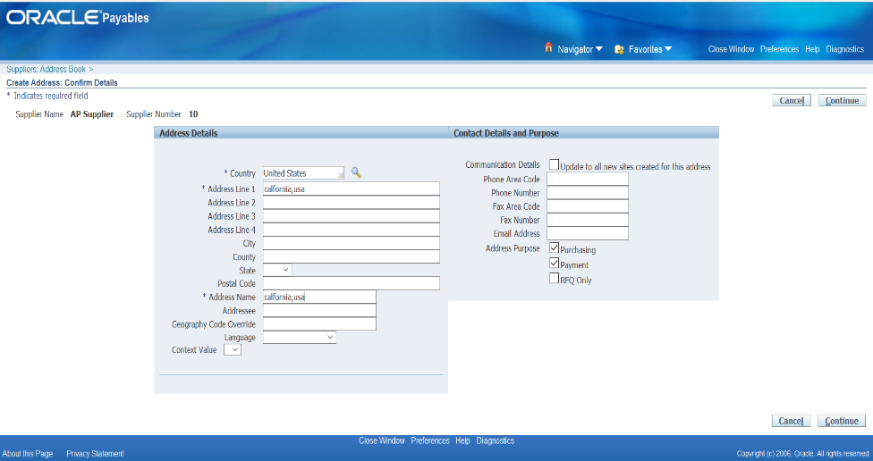
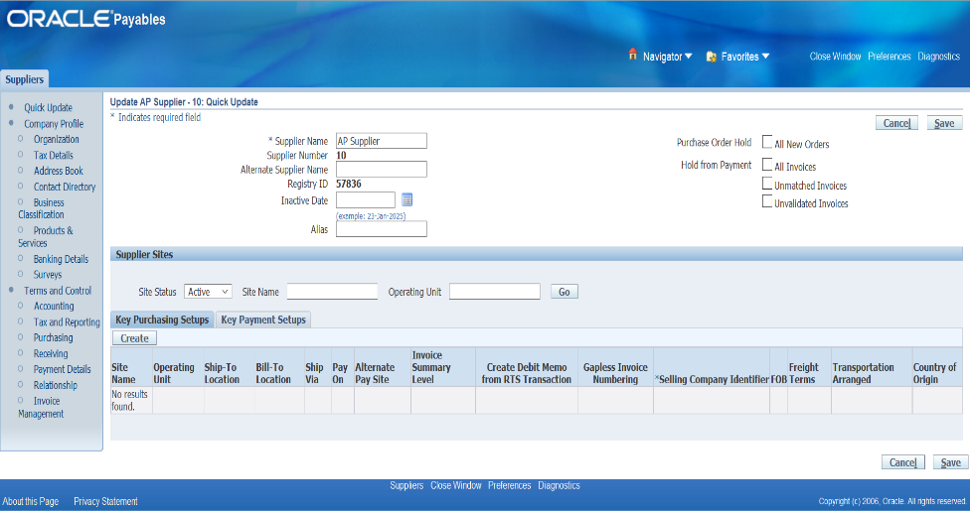
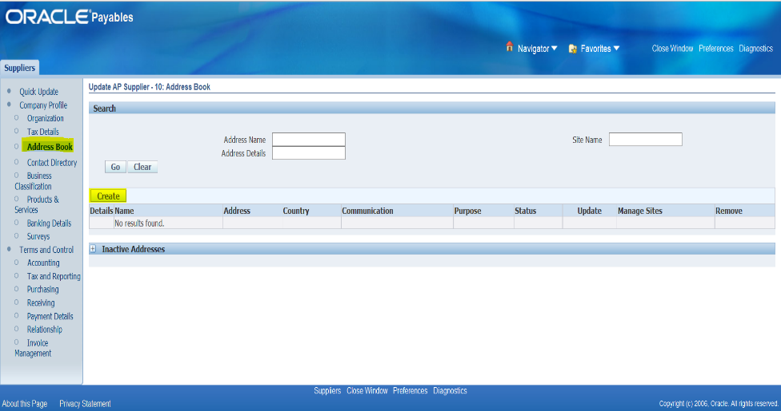
1. Create supplier
Suppliers
Entry
12
6
16
14
4
5
2
3
7
15
11
1
8
13
10
9

Slide 20
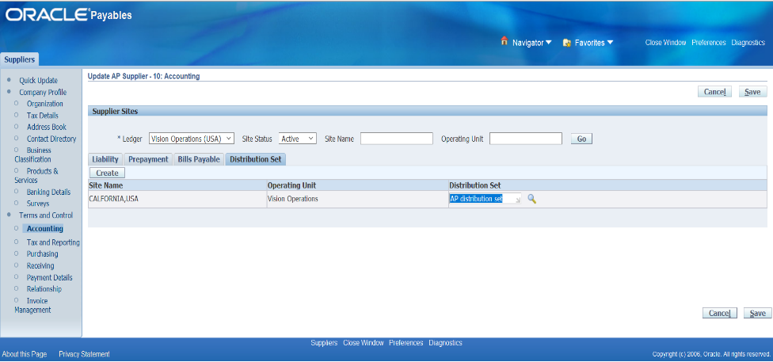
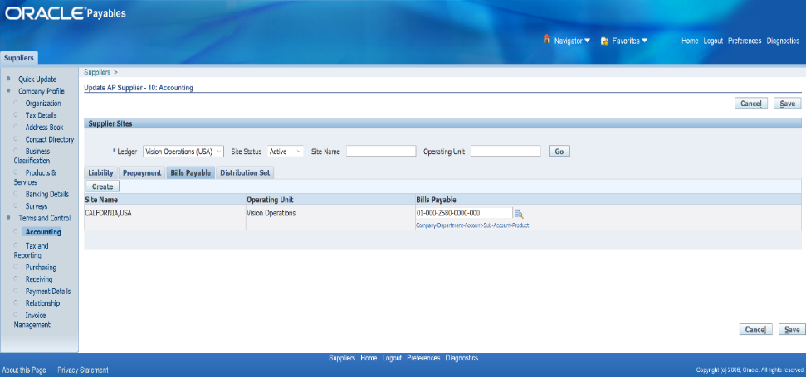
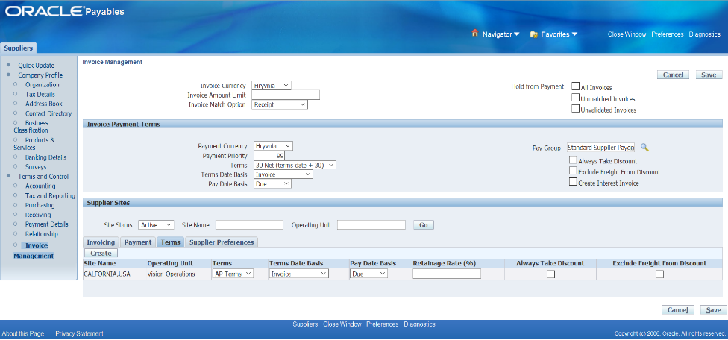

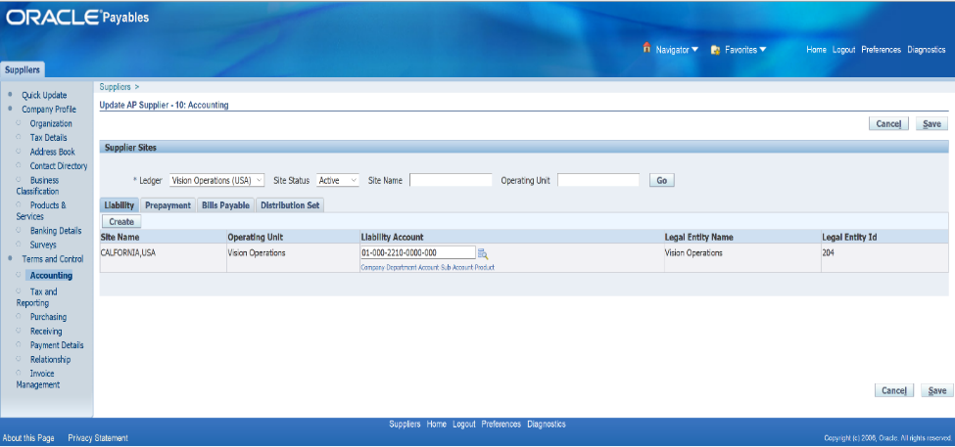
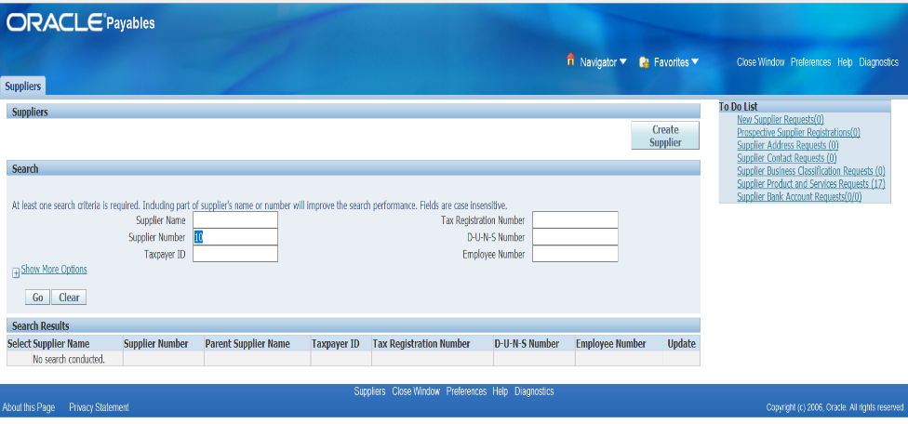
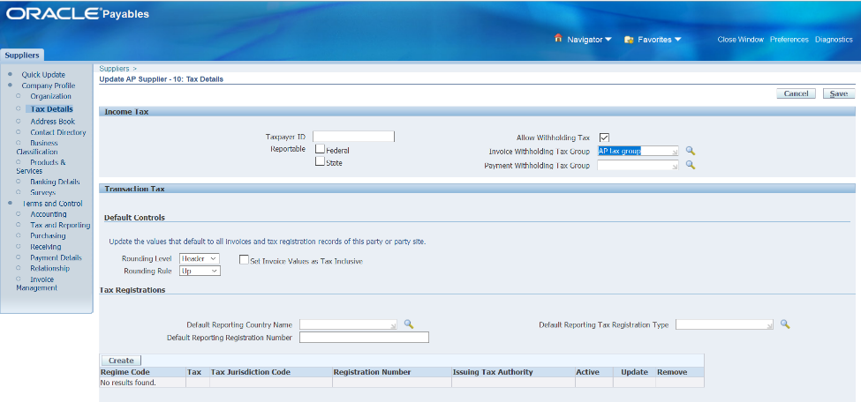
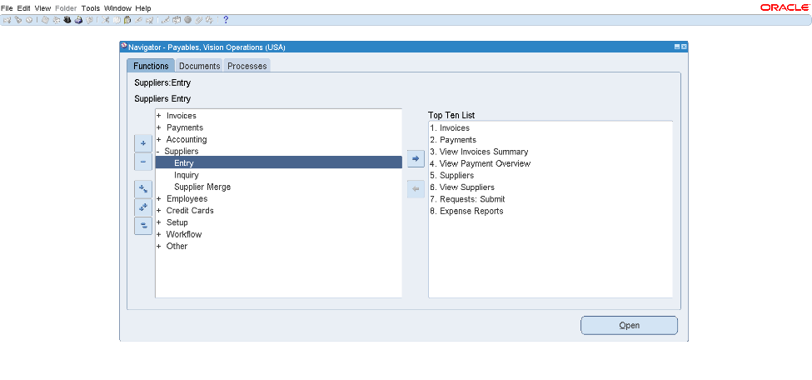
Adding Tax, Distribution set and Terms To The Supplier
Suppliers
Entry
Tax
Distribution set
Payment Terms
6
15
4
12
5
9
8
1
7
11
10
2
13
3
14

Slide 21
02
Invoices
Standard Invoice
Mixed Invoice
This is the most common type, used when a supplier sends us a bill for goods or services. It’s the regular invoice we need to pay.
invoice type that allows both positive (standard) and negative (credit memo or debit memo) amounts in a single transaction
Prepayment
Debit Memo
Payments made before receiving goods or services. It’s like paying in advance to secure a service.
Quick Invoice
This is issued when we owe the supplier more money, maybe because of underbilling or extra charges.
Credit Memo
A fast way to enter simple invoices when you don’t need all the details immediately. It saves time for straightforward transactions.
The opposite of a debit memo, this is when the supplier owes us money, like for returned goods or overpayments.

Slide 22
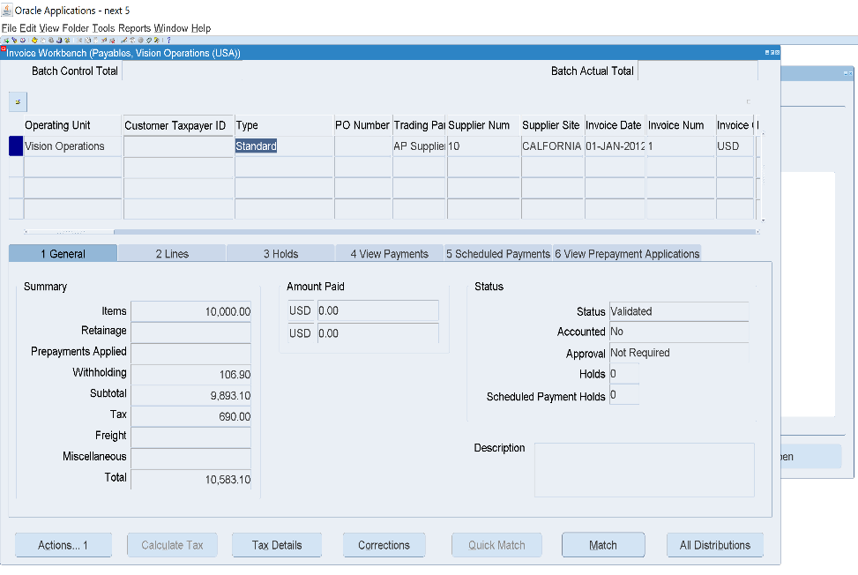
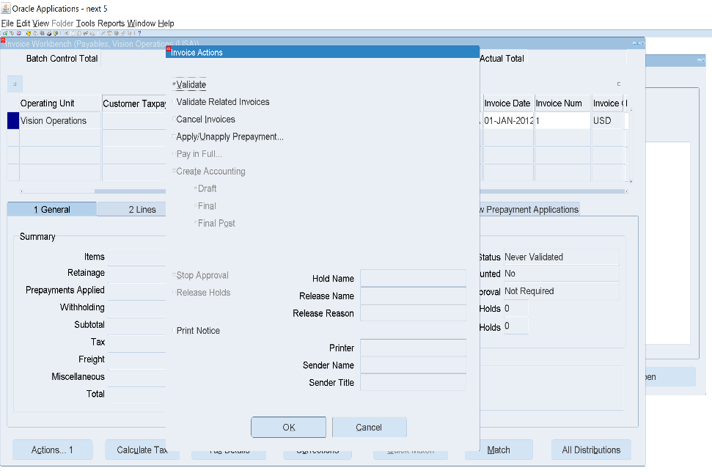
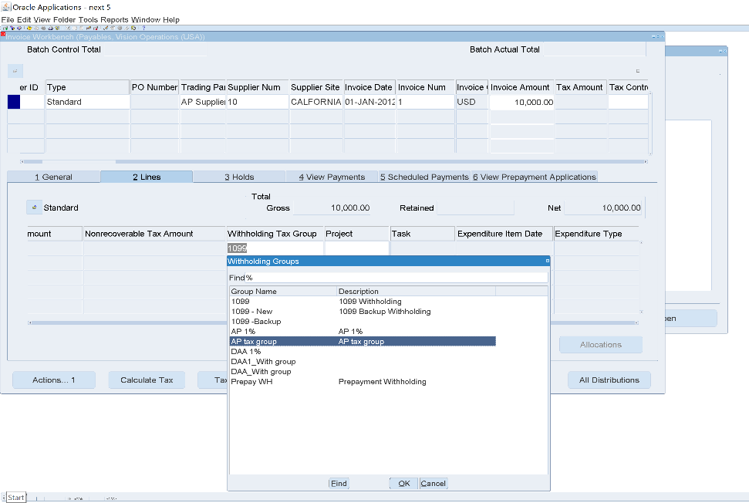
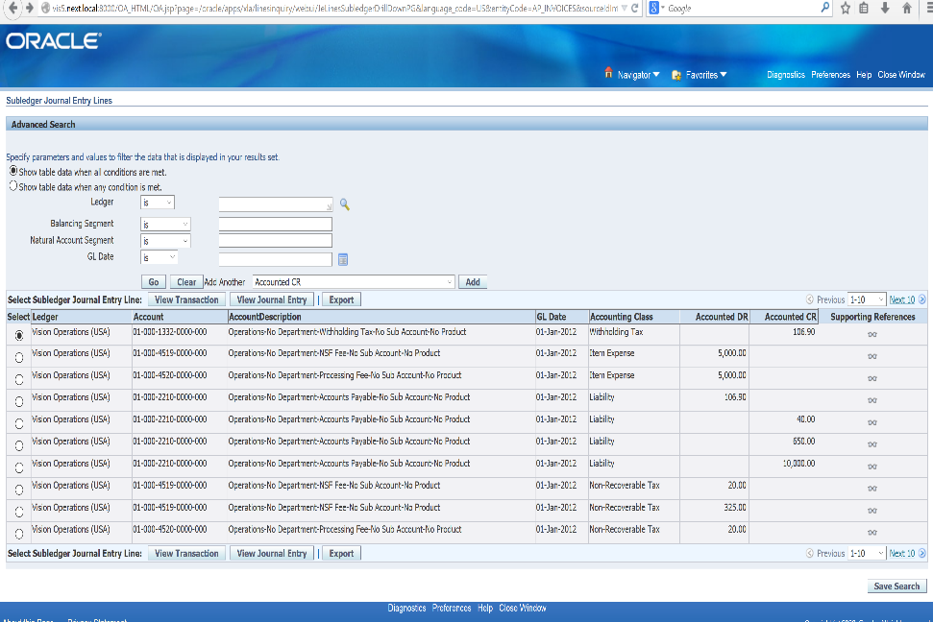
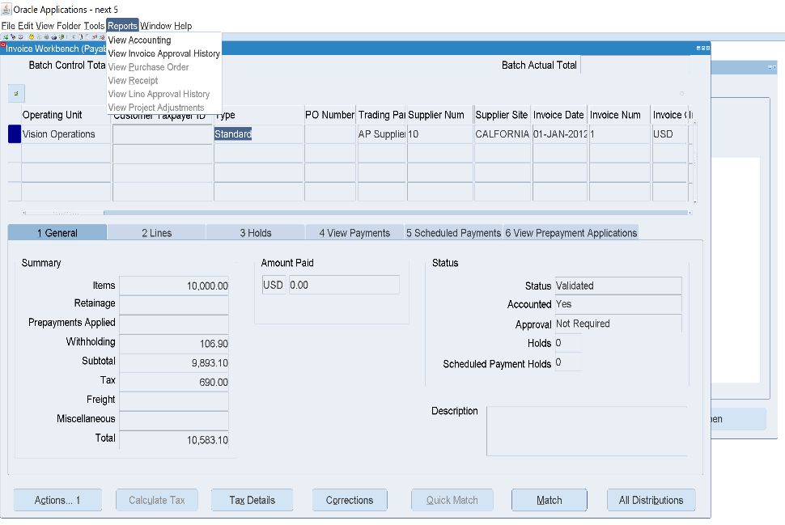
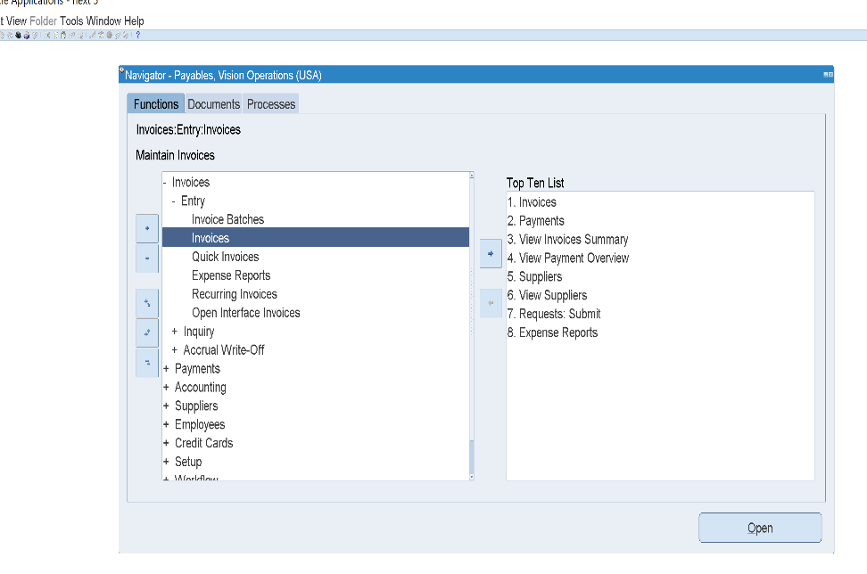
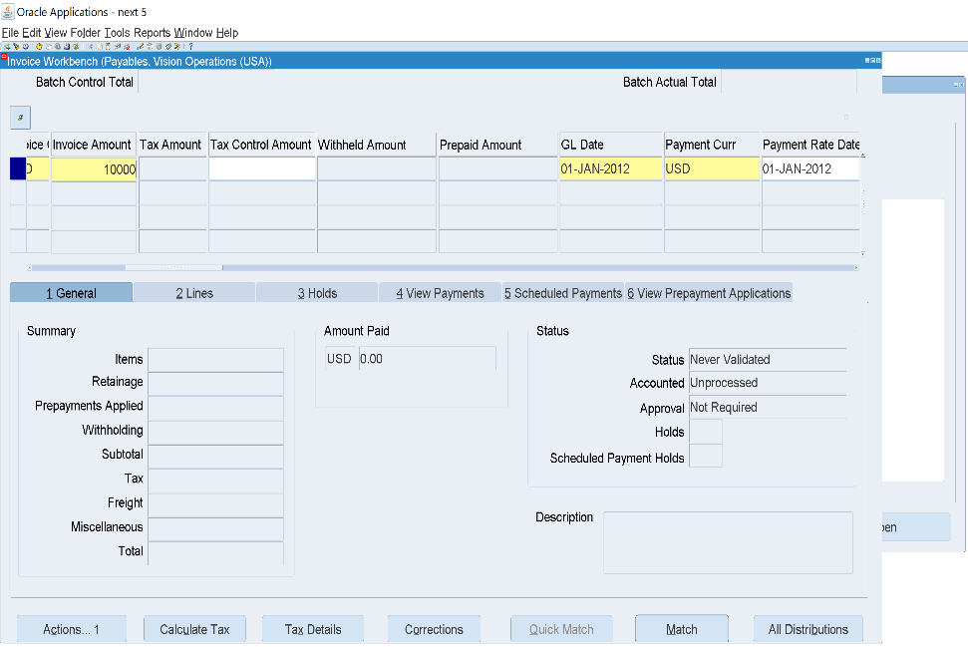
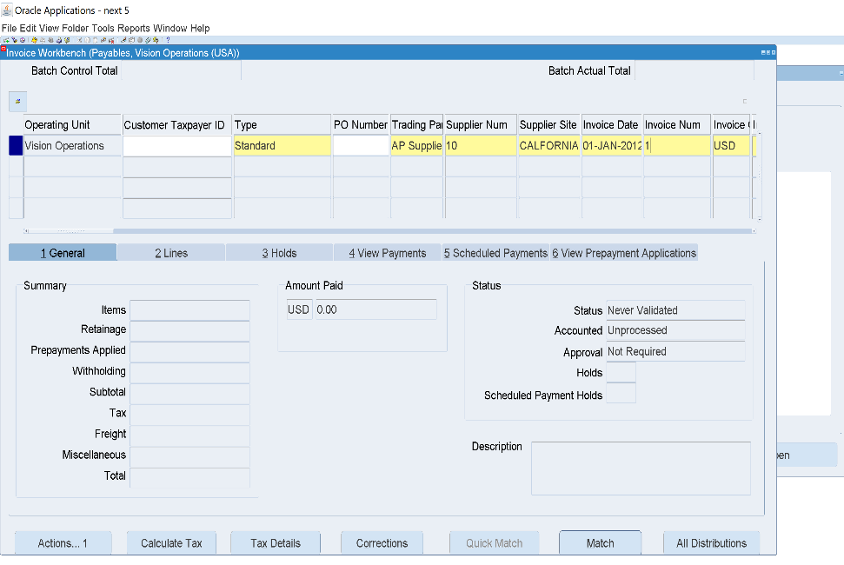
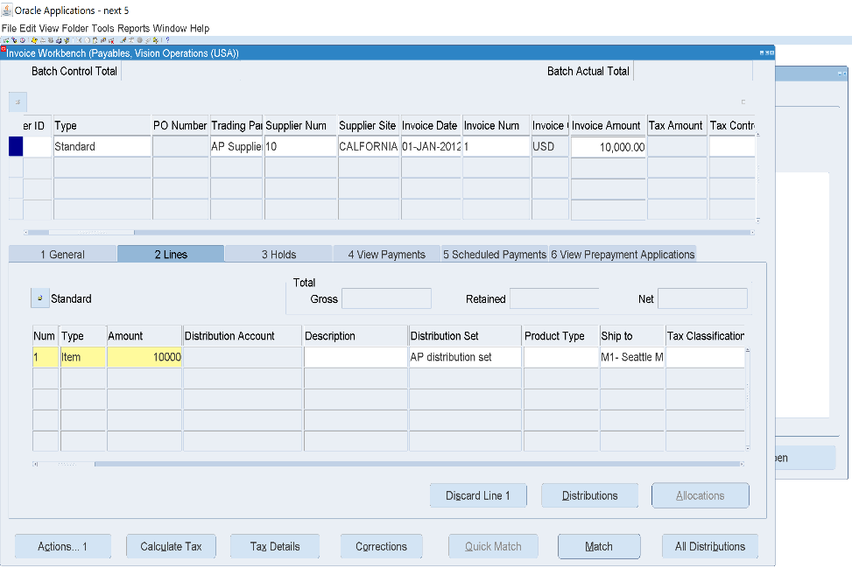
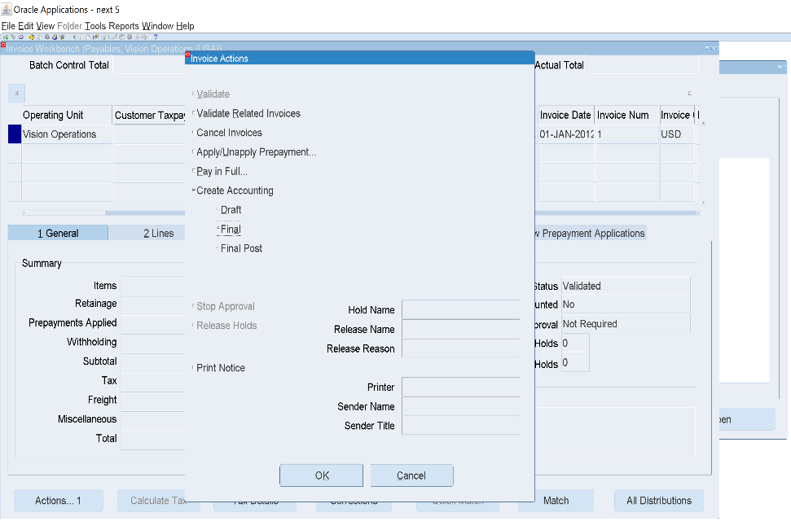
1.Create invoice
17
1- Standard invoice
Invoices
Entry
Invoices
12
2
3
4
5
6
7
8
15
1
10
Expenses
Tax
Liability
Withholding Tax
9
16
13
To view entries
11
14

Slide 23
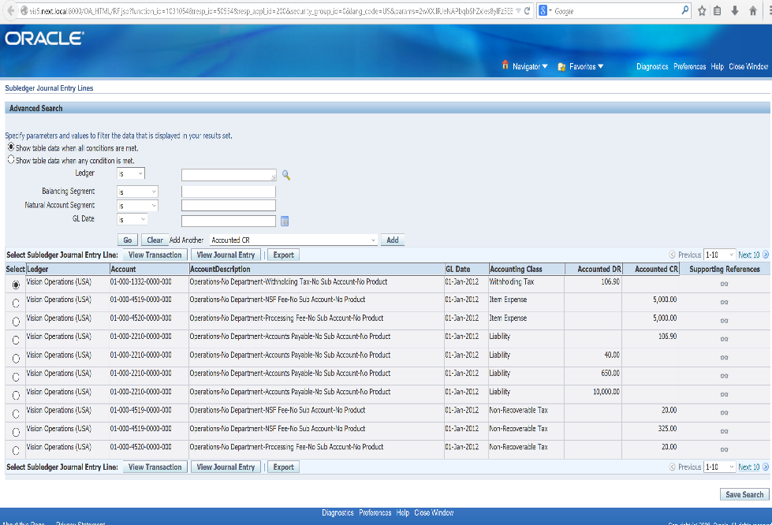
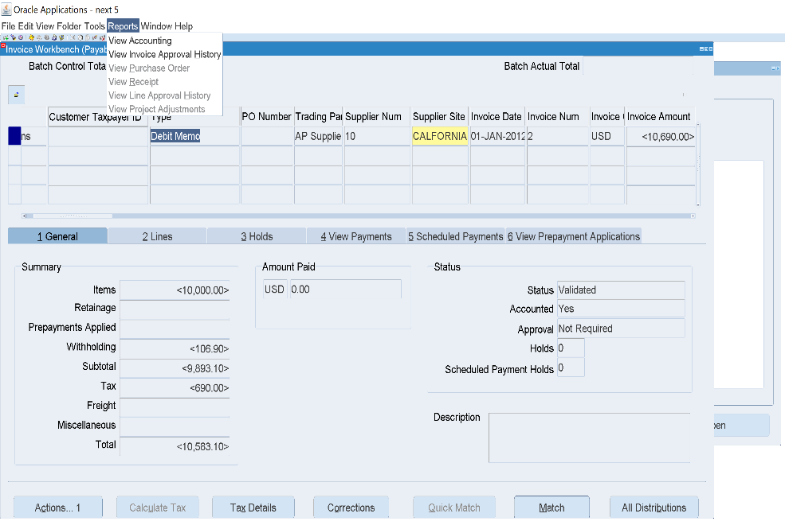
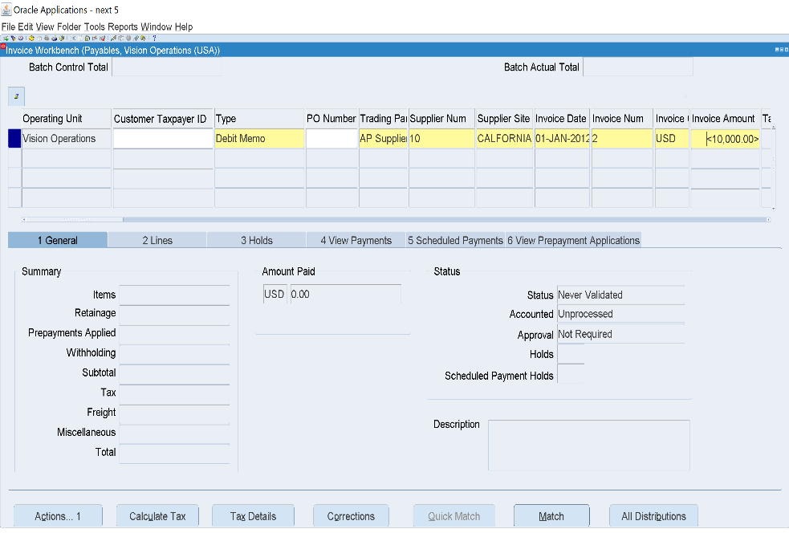
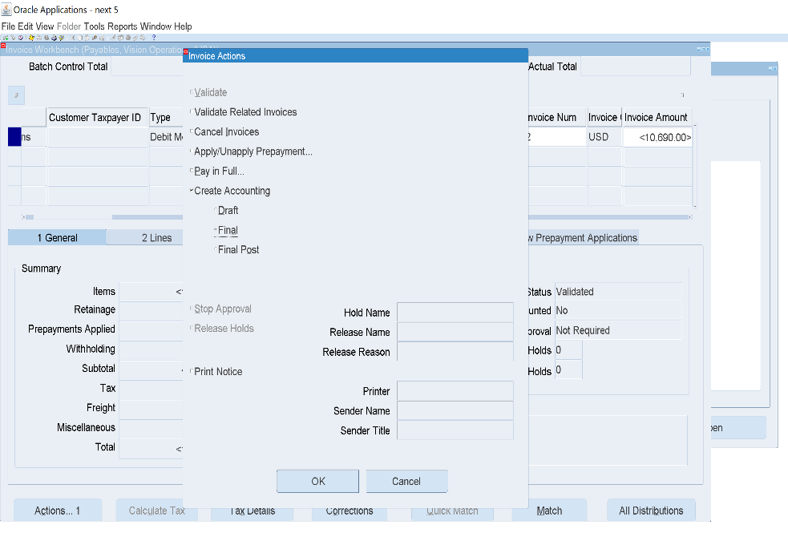
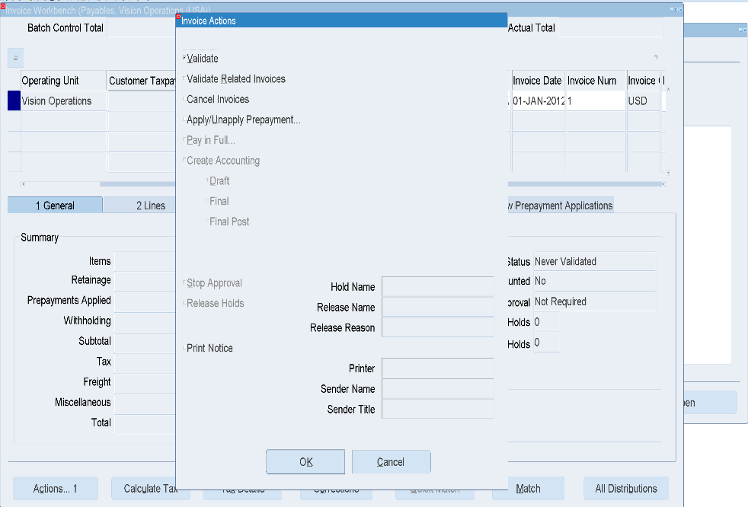
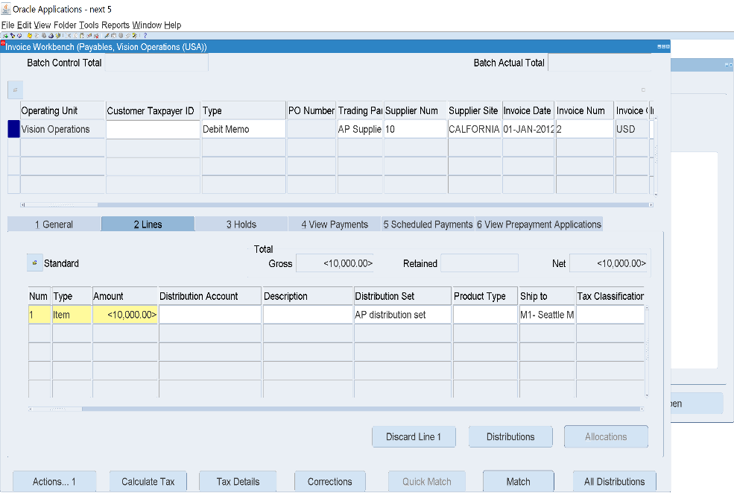
2- Debit Memo invoice
15
10
1
2
3
4
5
13
Liability
Withholding Tax
Expense
Tax
6
7
8
To view entries
14
11
12
9

Slide 24
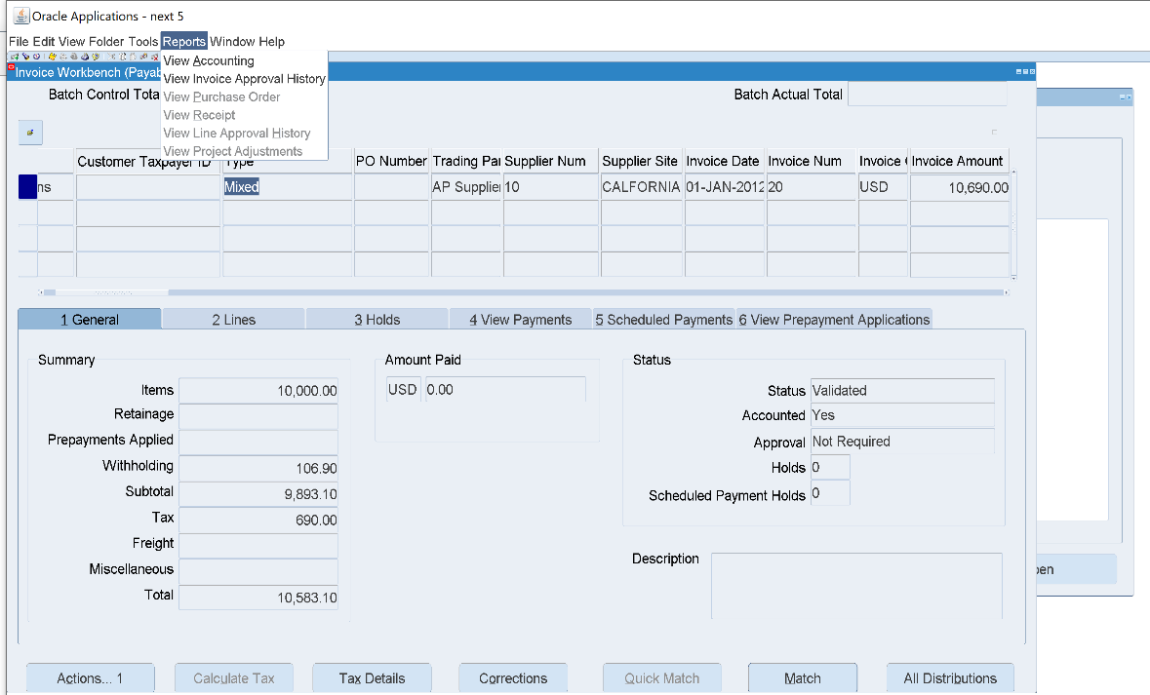









Mixed Invoice
Expenses
Liability
15
Supplier Info
10
1
3
4
5
2
To view entries
13
8
6
7
11
14
9
12

Slide 25








3- Prepayment invoice
Prepaid Expenses
Tax
Liability
Withholding Tax
To view entries
13
9
3
1
2
4
11
5
7
6
12
10
8

Slide 26


4- Quick invoice
Invoices
Entry
Quick Invoice
1
2
3

Slide 27








5- Credit Memo Using Quick invoice
To view Request
1
10
8
2
3
To view Entries
4
13
Liability
Withholding Tax
Expenses
Tax
5
6
11
14
12
7
9

Slide 28


Special Calander
Setup
Accounting
Special Calander
2
3
4
1
The year divided into three accounting periods

Slide 29



Recuring Invoice
Invoices
Entry
Recuring Invoice
4
2
5
3
6
1
7
9
8

Slide 30








1.Create Bank Account
03
Payment
Create Bank
Setup
Payment
Banks and bank branches
3
5
1
2
6
9
12
13
if you want to add bank address
7
11
and then if you have a bank contact and want to add it

Slide 31





Create bank branch
1
6
8
10
3
9
11
4
5
12
7
if you have a contact add want to add it

Slide 32












Create bank Account
8
6
Setup
Payment
Bank Account
9
13
16
4
18
19
17
3
2
1
5
11
14
15
12
20
21
7

Slide 33



To add payment documents
2
1
3

Slide 34









To pay invoices
Accounting Class | DR | CR
Liability | 10,583.10
Cash Clearing |  | 10,583.10
Search for invoice no. you want to pay and select it
Add supplier and all the info
Payments
Entry
Payment
To view journals
Tools
Accounting View
6
Click ctrl+s
2
7
1
4
5
8

Slide 35
Prepayment Cycle
01
01
01
01
Prepayment Invoice
Payment
Standard Invoice
Apply Prepayment
DR
DR
DR
DR
Prepaid Expense
10,000
Liability
AP Accrual 4,000
Liability 4,000
CR
CR
CR
CR
Liability10,000
Cash Clearing
Liability 4,000
Prepaid Expense
4,000
If all of this Payment done by mistake you can reverse all of this
01
01
Standard Invoice 2
Apply Prepayment 2
Cancel the invoice
DR
DR
AP Accrual 6,000
Void the payment
Liability 6,000
CR
CR
Liability 6,000
Prepaid Expense
6,000

Slide 36
























Paying Prepayment Invoice
To View entries
Prepaid Exp Tax
Liability Withholding Tax
24
3
15
10
19
7
16
6
Liability
Cash Clearing
To View entries
22
2
13
8
Expense Tax
Liability Withholding Tax
To View entries
3
23
1
11
21
14
9
18
5
Tax Liability
Prepaid Exp
12
20
17

Slide 37











04
Clearing
Bank statements
Manual clearing
clear transactions
8
14
2
9
12
5
6
Liability
Cash
Payment disappeared
Payments
1
4
3
Entry
10
7
11
13
Payments
6
Search for the Payment : (Number of payment is (6)

Slide 38








1- Create Accounting
05
Closing
View
Requests
Submit a new request
1
6
4
5
Set up your Parameters
9
7
8
2
3
Transfer Journal Entries to GL
Set up your Parameters
Submit

Slide 39




Subledger Period Close Exceptions Report
Set up your Parameters
Period Close Exceptions Report (XML)
Set up your Parameters
Submit
1
1

Slide 40




Invoice Register
3
Set up your Parameters
2
4
1

Slide 41




Invoice Validation
Submit
Invoice History
Set up your Parameters
Submit
1
2

Slide 42



Supplier Statement
Set up your Parameters
3
To setup the Format
Submit
2
4
1

Slide 43


Supplier Payment History
Set up your Parameters
1

Slide 44








Invoice Aging Report
1
CTRL+L
View – Requests Submit a new request
Set up your Parameters
4
Submit
2
3
4
1
View – Requests – Find
Ctrl + S
Report, View Output

Slide 45



06
General Ledger
1- Create Journals Entry, Post and Reverse Journal with 2 Ways.
Journal
Enter
1
1

Slide 46








Reverse Journals
1- Switch (Dr/Cr)
2- “Change Sign <>”
1
the journal status is “ unposted ” so click on post to make it post
3
Same steps but the difference is click on “Change Sign “
4
Date after the Entry date
6
2
Inactive Icon

Slide 47



Auto Copy entry
2
3
4
1

Slide 48








Recurring Journal
1
Journal
Define
Recurring
2
5
1
3
6
7
2
4
CTRL+S
CTRL+S

Slide 49




Define Daily rate and Create Journal with foreign Currency.
Setup
Currencies
Daily
9
2
3
6
7
4
5
8
10
1

Slide 50
Thank You
Do You Have Any Q

Slide 51
Payment Terms
Refer to the conditions agreed upon between a buyer and a supplier regarding when and how payments should be made for goods or services. These terms specify the due date, any discounts for early payment, late payment penalties, and the accepted payment methods.
Common Payment Terms Examples:
Net 30: Payment is due within 30 days of the invoice date.
Due on Receipt: Payment is required immediately upon receiving the invoice.
Payment terms help manage cash flow, set clear expectations, and ensure smooth financial transactions between businesses.

Slide 52
Distribution Set
is a predefined template that automatically allocates invoice amounts across multiple accounting distributions. It helps streamline the invoice entry process by ensuring consistent and accurate financial postings.
Types of Distribution Sets:
Full Distribution Set: Automatically assigns specific amounts or percentages to accounts.
Skeleton Distribution Set: Provides account coding without pre-assigned amounts, allowing flexibility to enter values manually.

Slide 53
Withholding Tax Code
Is a predefined code that determines the tax percentage or amount that must be deducted from supplier payments before processing. It ensures compliance with tax regulations by automatically calculating and applying withholding tax.

Slide 54
Withholding Tax Group
Is a collection of multiple Withholding Tax Codes applied together to a supplier or transaction. It allows businesses to apply multiple tax rates at the same time, simplifying tax deduction and compliance.

Slide 55
Recurring Invoice
Is an invoice that is automatically generated at regular intervals for expenses that occur repeatedly, such as rent, subscriptions, or utility bills. Instead of manually entering the same invoice every period, Oracle allows businesses to set up a recurring schedule.

Slide 56
04
Clearing
a report showing only the transactions that have been fully processed and finalized, with no pending items.

Slide 57
05
Closing
A Set of financial statements and analyses generated during the period-end closing process.
These reports summarize and provide detailed insights into the account payable activities for a specific period, ensuring that all transactions have been accounted for and reconciled.

Slide 58
Create Accounting
Create Accounting is an essential report that provides a detailed summary of the journal entries created during the accounting process for transactions recorded in the Accounts Payable (AP) module. It is typically run after the completion of transactions and before posting to the General Ledger (GL) to ensure the proper recording of financial data.

Slide 59
Transfer Journal Entries to GL
is a report generated during the process of transferring accounting entries from the subledger (such as Accounts Payable) to the General Ledger (GL). This report provides details about the journal entries that have been successfully transferred or are pending transfer to the GL, ensuring that the financial data is accurately reflected in the General Ledger.

Slide 60
Subledger Period Close Exceptions Report
Is a report generated during the period-end closing process in the subledger modules (such as Accounts Payable, Accounts Receivable, and others). It identifies any discrepancies, errors, or issues that prevent the subledger from closing successfully, ensuring that all transactions are properly accounted for before transferring them to the General Ledger (GL).

Slide 61
Period Close Exceptions Report (XML)
is an electronic version of the Subledger Period Close Exceptions Report. It provides the same information about discrepancies or errors that prevent the subledger from closing successfully but in an XML format, which is useful for automated processing, integrations, and external reporting purposes.

Slide 62
Invoice Register
Is a standard report in Oracle Financials R12 Accounts Payable (AP) that provides a detailed listing of all invoices entered into the system within a specified period. This report helps businesses track, review, and reconcile invoices before financial closing and reporting.

Slide 63
Invoice Validation
Is a process in Oracle R12 Accounts Payable (AP) that ensures all invoices entered into the system meet predefined accounting and business rules before they are approved for payment. This process checks for errors, inconsistencies, and missing information to prevent incorrect payments and maintain financial accuracy.

Slide 64
Invoice History Report
Provides a detailed audit trail of all activities and changes related to invoices within a specified period. It helps track the lifecycle of an invoice, including creation, approvals, modifications, holds, and payments.

Slide 65
Supplier Statement
A detailed summary of transactions between a company and a supplier within a specific period. It helps track outstanding balances, payments made, and pending invoices, ensuring reconciliation between the supplier's records and the company's financial records. This report is critical for finance teams and accounts payable departments to maintain transparency, avoid payment delays, and strengthen supplier relationships.

Slide 66
Supplier Payment History
provides a detailed record of all payments made to a supplier over a specific period. It helps businesses track payment transactions, reconcile supplier accounts, and ensure that all invoices have been settled correctly

Slide 67
Invoice Aging Report
provides a detailed analysis of outstanding supplier invoices by categorizing them based on their due dates. This report helps businesses track overdue invoices, prioritize payments, and manage cash flow effectively.

Slide 68
Reverse Journal
means creating an opposite (negative) entry to nullify a previously recorded transaction. This is commonly used for adjustments, accruals, and error corrections. Oracle allows two types of journal reversals:
Switch Dr/Cr (Switch Debit & Credit)
How it works: This method swaps the debits and credits in the journal entry.
Change Sign
How it works: This method simply negates the original amounts, keeping debits as debits and credits as credits but changing their values to negative.

Slide 69
Auto Copy Batch
Is a feature in Oracle that allows users to duplicate a group of journal entries or transactions from a previous period and apply them to a new period. This is useful for repetitive financial entries, such as monthly expenses, payroll, or accruals.

Slide 70
Recurring Journal
Is a journal entry that is automatically generated periodically (e.g., monthly, quarterly) for repeated financial transactions. Instead of manually entering the same journal each period, Oracle allows users to set up Recurring Journals to save time and reduce errors.

